Slide 1
OPEN FOR INNOVATION: The role of openness in explaining innovation performance among UK manufacturing firms
Laursen, Keld, and Ammon Salter. 2005
Strategic Management Journal 27: 131-150
[STP510] SeungChan Choi

Slide 2
Contents
Introduction
Theoretical Background
Hypotheses
Data and Methods
Discussion and Conclusions

Slide 3
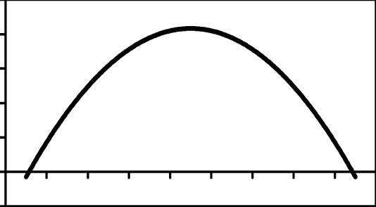
Preview of Conclusion
Innovative performance
openness

Slide 4
Introduction
The success of firm innovation is linked to openness (Chesbrough, 2003)
How External research strategies affect to innovative performance
Concept of “Breadth” and “Depth”
More open firm are innovative performance
Excessive openness has a negative impact for innovative performance

Slide 5
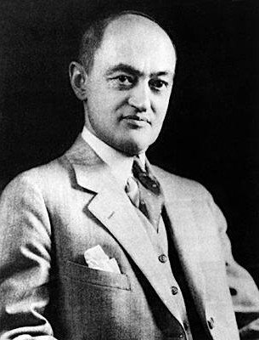
Theoretical Background
Schumpeterian Model
Creative Destruction
1) Technical Innovative is the power which lead Capitalism
2) Entrepreneurs are the driving force behind innovation
Joseph Alois Schumpeter
1883~1950
Austria, United States

Slide 6

Theoretical Background
Chesbrough: Open Innovation
Internal R&D??
Easy to miss opportunities and ideas created outside the firm.
Ex) P&G, “connect and develop”, (External > Internal)
Three way of research approach
Firm’s external search efforts for innovation
Mainly focus on patent, not research
U.K case analysis study
Henry Chesbrough
1956 ~
American

Slide 7
Hypothesis
Relation between ‘openness’ and ‘innovative performance’
‘openness’ could understand as ‘external source knowledge’
‘external source knowledge’ could categorize into ‘Breadth’ and ‘Depth’
Excessive investment for ‘external source knowledge’ could cause negative results

Slide 8
Hypothesis
H1/2: External search breadth/depth is curvilinearly (taking an inverted U-shape) related to innovative performance
H3/4: The more radical the innovation, the less effective external search breadth/depth will be in influencing innovative performance
H5: Drawing deeply from lead users in innovative search increases the probability of the firm to achieve innovative performance

Slide 9
Hypothesis
For H1/2, Excessive investment can cause negative results (Kpout, 1997)
Too much idea to manage and select
Only few of idea attempt to implement
Lot of innovative idea have emerge in wrong time and space
Attention-based theory: Firm have to make good choices (Ocasio, 1997)

Slide 10
Hypothesis
Radical Innovation need “competence-enhancing” or “competence-destroying” among firms working within the industry (Tushman and Anderson)
Innovation need R&D investment, probablity of success and the reward are inversely proportional (성공 가능성과 보상은 반비례한다) (Schumpeter, Marsili & Salter, 2003)
Resources for novel innovation are rare
Once it has success, that resource become normal
Ex) Smart Phone

Slide 11
Data and Methods
2001, Eurostat Community Innovation Survey (CIS), UK innovation survey
Yale Survey and SPRU innovation database
Patent statistics are useful
Dependent variable
INWORLD: Percentage of firm’s revenue associated with products on the global market
INFIRM: Firm’s new product number
INNIMP: Percentage of corporate sales associated with new products
Independent variable
Breadth, Depth
R&D Investment, Employee number, Start-up, Locality

Slide 12
Discussion and Conclusions
Innovative performance
openness

Slide 13
Discussion and Conclusions
Openness is positive for Innovative
Inverted U model, excessive openness can cause decrease in innovative performance
Should well be calculated for the cost
Future research
How the link channel built (process)
How firm can find the openness tipping point

